Slide 1


Evaluation: Introduction and Heuristics
Human Computer Interaction
Alberto Monge Roffarello
Academic Year 2023/2024
Notes:
Experts checking our designs according to some principles.

Slide 2
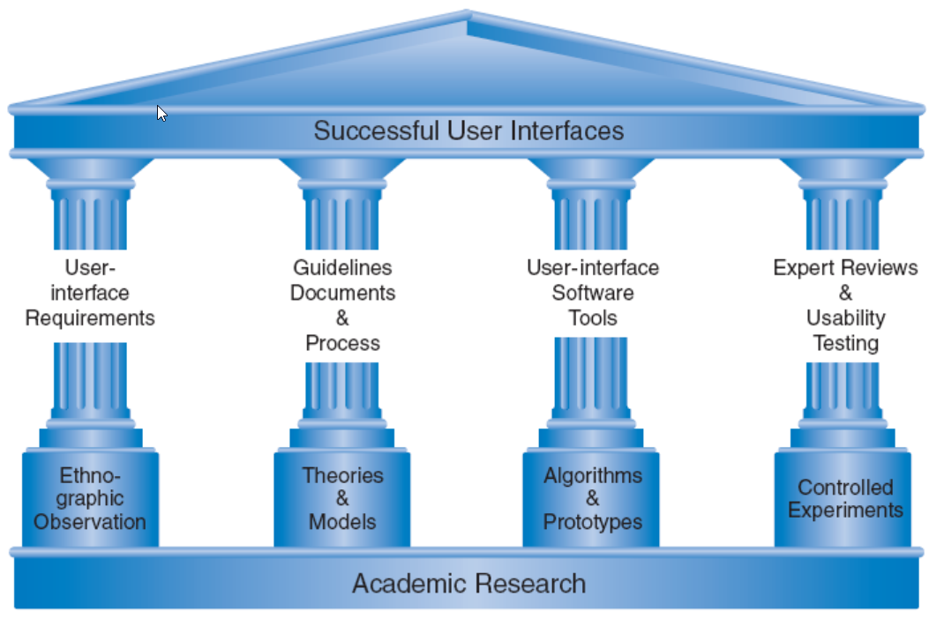
The Four Pillars of Design
Ben Shneiderman & Catherine Plaisant, Designing the User Interface: Strategies for Effective Human-Computer Interaction
Notes:
Evaluation: it’s not something that happens at the end of the design process, only. You should have different evaluations in your design process, which is actually an iterative process. Fix issues as soon as possible.

Slide 3
Goals
Generating design solutions
Guidelines
Principles
Theories
Evaluating generated designs
Expert reviews and heuristics
Usability testing
Controlled experiments
Design Patterns

Slide 4
Evaluation
Testing the usability, functionality and acceptability of an interactive system

Slide 5
Goal
Evaluation: «Evaluation tests the usability, functionality and acceptability of an interactive system»
According to the design stage (sketch, prototype, final)
According to the initial goals
Alongside the different usability dimensions
Using a range of different techniques
Identify and correct issues as soon as possible

Slide 6
Usability
Usability: how well users can use the system’s functionality.
Dimensions of usability:
Usefulness: does it do something people want?
Learnability: is it easy to learn?
Memorability: one learned, is it easy to remember?
Effectiveness: does it allow reaching the goal?
Efficiency: once learned, is it fast to use?
Visibility: is the state of the system visible?
Errors: are errors few and recoverable?
Satisfaction: is it enjoyable to use?

Slide 7
Functionality
Functionality: the system’s functionality must accord with the user’s requirements and should enable users to perform their intended tasks.
Functionality can be tested in different ways:
Are the appropriate functionality available within the system?
Are they clearly reachable by the user?
Do they match the the user’s expectations?
Functionality evaluation may also include measuring the user’s performance with the system, to assess the effectiveness of the system in supporting the task.
Notes:
Here we are testing if the functionality are compliant with the user needs.

Slide 8
Acceptability
Technology acceptability is one’s perception of a system before use, while technology acceptance is one’s perception of the system after use.
Good User Interface Design can make a product easy to understand and use, which results in greater user acceptance.
Testing acceptability means evaluating the enjoyment and emotional response to a system, particularly in the case of systems that are aimed at leisure or entertainment.
This may involve:
measuring satisfaction and comfort
identifying areas of the design that overload the user
Notes:
The degree to which the user will accept the system in their daily life.
Recommender system which shows thousands of suggestions in the hope page: overload.

Slide 9
Many Evaluation Approaches
Evaluation may take place:
In the laboratory
In the ﬁeld

Slide 10
Many Evaluation Approaches
In lab studies, users are taken out of their normal work environment to take part in controlled tests. They are typically adopted in the early stages of design (e.g., to compare alternatives, you don’t need a working implementation).
simulation of dangerous environments
suitable for specific tasks within a system
lack of context
unnatural situations leading to biases
not suitable for all the tasks
Notes:
In the aerospace domain, before sending astronauts in the space, you probably would need to conduct a lab study simulating the dangerous environment, just to check that the interface of the spaceship is not terrible.
Running behaviors cannot be tested in the lab.

Slide 11
Many Evaluation Approaches
Field studies takes the designer or evaluator out into the user’s work environment in order to observe the system in action.
open nature: the “real” context
users are in their natural environment
low degree of control
higher costs (you need a working implementation)
longer duration

Slide 12
Many Evaluation Approaches
Evaluation may be based on expert evaluation:
Analytic methods
Review methods
Model-based methods
Heuristics
It is useful to identify any areas that are likely to cause difficulties because they violate known cognitive principles, or ignore accepted empirical results
it can be used at any stage in the development process
it is relatively cheap, since it does not require user involvement
it does not assess actual use of the system
Notes:
Easy to solve problems. 3-5 exeprts.

Slide 13
Many Evaluation Approaches
Evaluation may involve users:
Experimental methods
Observational methods
Query methods
Formal or semi-formal or informal
In experimental and observational methods, the evaluator chooses a hypothesis to test, which can be determined by measuring some attribute of participant behavior.
they provide empirical evidence
they require more time to be designed and analyzed
Query techniques (e.g., interviews) relies on asking the user about the interface directly
they are simple and cheap
you get subjective results
Notes:
Experimental/observational: we test the hypothesis looking at users using our system -> empirical evidence
Query/interviews -> can be used for needfinding but also for evaluation (asking users opinions about the system)

Slide 14
Many Evaluation Approaches
We can also adopt automated evaluation:
Simulation and software measures
Formal evaluation with models and formulas
Especially for low-level issues
Notes:
45

Slide 15
Heuristic Evaluation
Experts check potential issues on your design, by referring to a set of heuristic criteria
Notes:
We look for usability problems…asking to experts

Slide 16
When Is Design Critique Useful?
Before user testing
To save effort
Solving easy-to-solve problems
Leaving user testing for bigger issues
Before redesigning
Identify the good parts (to be kept) and the bad ones (to be redesigned)
To generate evidence for problems that are known (or suspected)
From ‘murmurs’ or ‘impressions’ to hard evidence
Before release
Smoothing and polishing
Notes:
Expert will critique your design…in a constructive way.
Easy to solve: you don’t need the target population to know that your black text on top of that very dark image is not readable…
Known problems, our app is on the playstore and we are receiving a lot of bad reviews…

Slide 17

Heuristic Evaluation
A method developed by Jacob Nielsen (1994)
Structured design critique
Using a set of simple and general heuristics
Executed by a small group of experts (3-5)
Suitable for any stage of the design (sketches, UI, …)
Goal: find usability problems in a design
Also popularized as “Discount Usability”
A heuristic is a guideline or general principle or rule of thumb that can guide a design decision or be used to critique a decision that has already been made.
Notes:
Work with Norman
You can also define your own heuristics

Slide 18

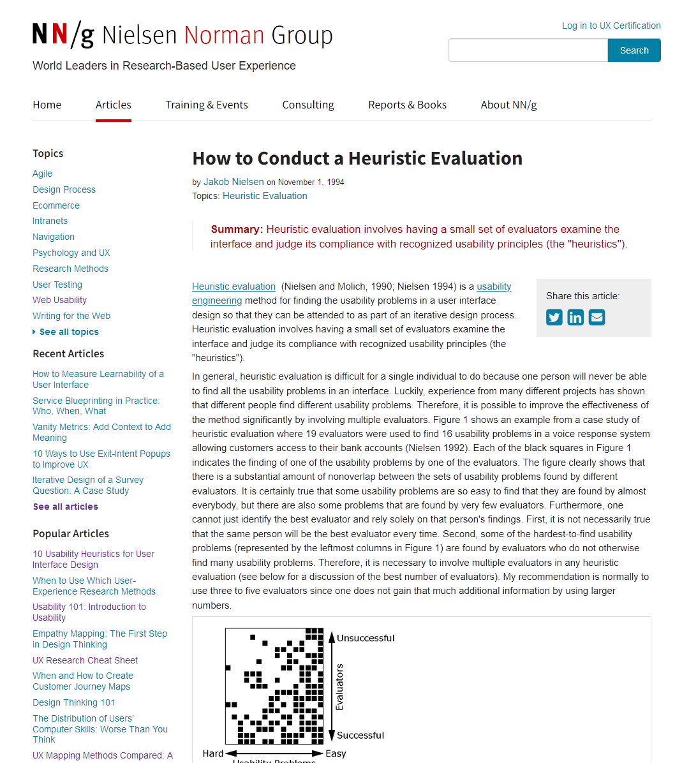
Basic Idea
https://www.nngroup.com/articles/how-to-conduct-a-heuristic-evaluation/
Define a set of heuristics (or principles)
Give those heuristics to a group of experts
Each expert will use heuristics to look for problems in the design
Experts work independently
Each expert will find different problems
At the end, experts communicate and share their findings
Findings are analyzed, aggregated, ranked
The discovered violations of the heuristics are used to fix problems or to re-design

Slide 19
Heuristics
Nielsen proposed 10 heuristic rules
Good at finding most design problems
Inspired and connected to the Design Principles (→Guidelines)
In a specific context, application domain, or for specific design goals …
… new heuristics can be defined
… some heuristic can be ignored
Notes:
Some heuristics can be ignored –> fonts, colors, … cannot be assessed on a low fidelity prototype

Slide 20
Phases of Heuristic Evaluation
Pre-evaluation training
Give evaluator information about the domain and the scenario to be evaluated
Evaluation
Individual
Severity Rating
First, individually
Then, aggregate and find consensus
Debriefing
Review with the design team
Notes:
(1) The evaluator can try to impersonate a user of the target population

Slide 21
Evaluation (I)
Define a set of tasks, that the evaluators should analyze
For each task, the evaluator should step through the design several times, and inspect the UI elements
On the real design, or on a preliminary prototype
At each step, check the design according to each of the heuristics
1st step, get a general feeling for the interaction flow and general scope
2nd step (and following), focus on specific UI elements, knowing where they fit in the general picture
Heuristics are used as a “reminder” of things to look for
Other types of problems can also be reported

Slide 22
Evaluation (II)
Comments from each evaluator should be recorded or written
There may be an observer, taking notes
The observer may provide clarifications, especially it the evaluator is not a domain expert
Session duration is normally 1h – 2h
Each evaluator should provide a list of usability problems
Which heuristic (or other usability rule) has been violated, and why
Not a subjective comment, but a reference to a known principle
Each problem reported separately, in detail

Slide 23
Evaluation (III)
https://www.nngroup.com/articles/usability-problems-found-by-heuristic-evaluation/
Where problems may be found
A single location in the UI
Two or more locations that need to be compared
Problem with the overall UI structure
Something is missing
May be due to prototype approximation
May still be unimplemented
Notes:
Two or more locations→ the designer is using different labels for the same kind of button, e.g., search and find
UI stricture-> the designer is not using conventions, patterns, common in a specific ecosystem (a website navigation bar that is placed on the bottom of the page rather than on the top)

Slide 24
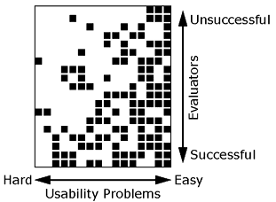
Multiple Evaluators
No evaluator finds all problems
Even the best one finds only ~1/3
Different evaluators find different problems
Substantial amount of nonoverlap
Some evaluators find more problems than others
19
16
Notes:
The magic number cannot be 1, but with 5 evaluators you will find most of the problem

Slide 25
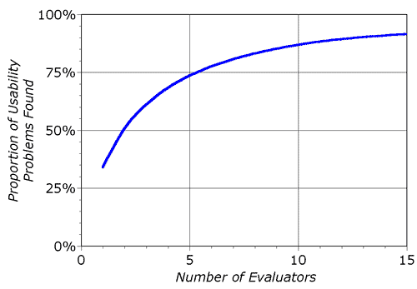
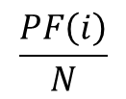

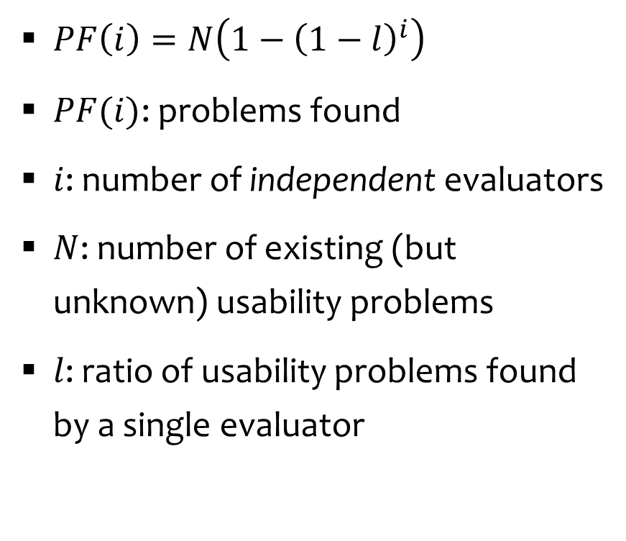
How Many Evaluators?
$PF\left(i\right)=N\left(1−{\left(1−l\right)}^{i}\right)$
$PF(i)$: problems found
$i$: number of independent evaluators
$N$: number of existing (but unknown) usability problems
$l$: ratio of usability problems found by a single evaluator
$$\frac{PF\left(i\right)}{N}$$
$$i$$
Notes:
And this magic number was confirmed by other analyses. Here you can see the ratio between the problems found and the number of evaluators…It’s not linear, after five evaluators this ratio tends to stabilize.

Slide 26
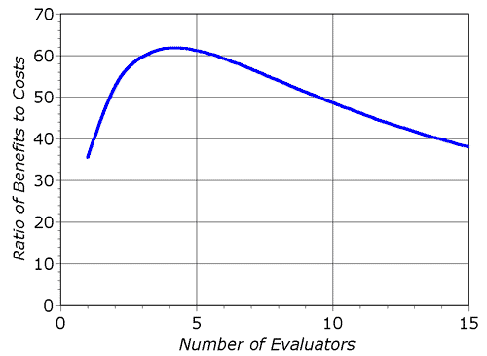
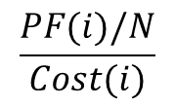
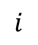
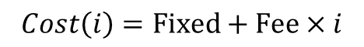
How Many Evaluators?
$$Cost\left(i\right)=\text{Fixed}+\text{Fee}×i$$
$$\frac{PF(i)/N}{Cost(i)}$$
3-5
$$\frac{PF\left(i\right)}{N}$$
$$i$$
$$i$$
Notes:
And of course, the cost of recruiting more experts increases, and so the advantages of having more than 5 experts decreases.

Slide 27
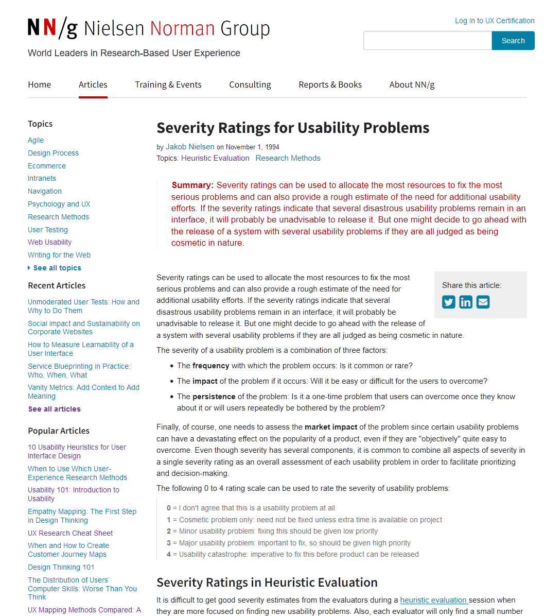
Severity Rating
https://www.nngroup.com/articles/how-to-rate-the-severity-of-usability-problems/
We need to allocate the most resources to fix the most serious problems
We need to understand if additional usability efforts are required
Severity is a combination of:
Frequency with which the problem occurs: common or rare?
Impact of the problem if it occurs: easy to overcome or difficult?
Persistence, is it one-time or will it occur many times to users?
Define a combined severity rating
Individually, for each evaluator
Notes:
Rare or common…is the design problem present in all the pages, or is it specific to a single page?
Can the user interact with the system even if there is that design problem?
Is the problem happening every time I click the button? Then it’s probably a severe problem…Is the problem showing just the first time that I click the button? Then the severity may be low.

Slide 28
Severity Ratings scale
0 | No problem | I don't agree that this is a usability problem at all
1 | Cosmetic problem only | need not be fixed unless extra time is available on project
2 | Minor usability problem | fixing this should be given low priority
3 | Major usability problem | important to fix, so should be given high priority
4 | Usability catastrophe | imperative to fix this before product can be released
Frequency
Impact
Persistence
Notes:
0 -> used in the consensus phase

Slide 29
Combined Severity Ratings
Severity ratings from one evaluator have been found unreliable, they should not be used
After all evaluators completed their rankings
Either let them discuss, and agree on a consensus ranking
Or just compute the average of the 3-5 ratings

Slide 30
Debriefing
Meeting of all evaluators, with observers, and members of the development team
Line-by-line analysis of the problems identified
Discussion: how can we fix it?
Discussion: how much will it cost to fix it?
Can also be used to brainstorm general design ideas

Slide 31
Heuristic Evaluation vs. User Testing
Heuristic Evaluation
User Testing
Faster (1-2h per evaluator)
Results are pre-interpreted (thanks to the evaluators)
Could generate false positives
Might miss some problems
Need to develop software, and prepare the set-up
More accurate (by definition!)
Actual users and tasks
… more on this later in the course!

Slide 32
Heuristic Evaluation vs. User Testing
Heuristic Evaluation
User Testing
Faster (1-2h per evaluator)
Results are pre-interpreted (thanks to the evaluators)
Could generate false positives
Might miss some problems
Need to develop software, and prepare the set-up
More accurate (by definition!)
Actual users and tasks
… more on this later in the course!
Alternate the methods!
Find different problems
Do not waste participants
https://www.nngroup.com/articles/usability-problems-found-by-heuristic-evaluation/

Slide 33
Nielsen’s Usability Heuristics
10 Usability Principles to be used in Heuristic Evaluation
Notes:
35

Slide 34
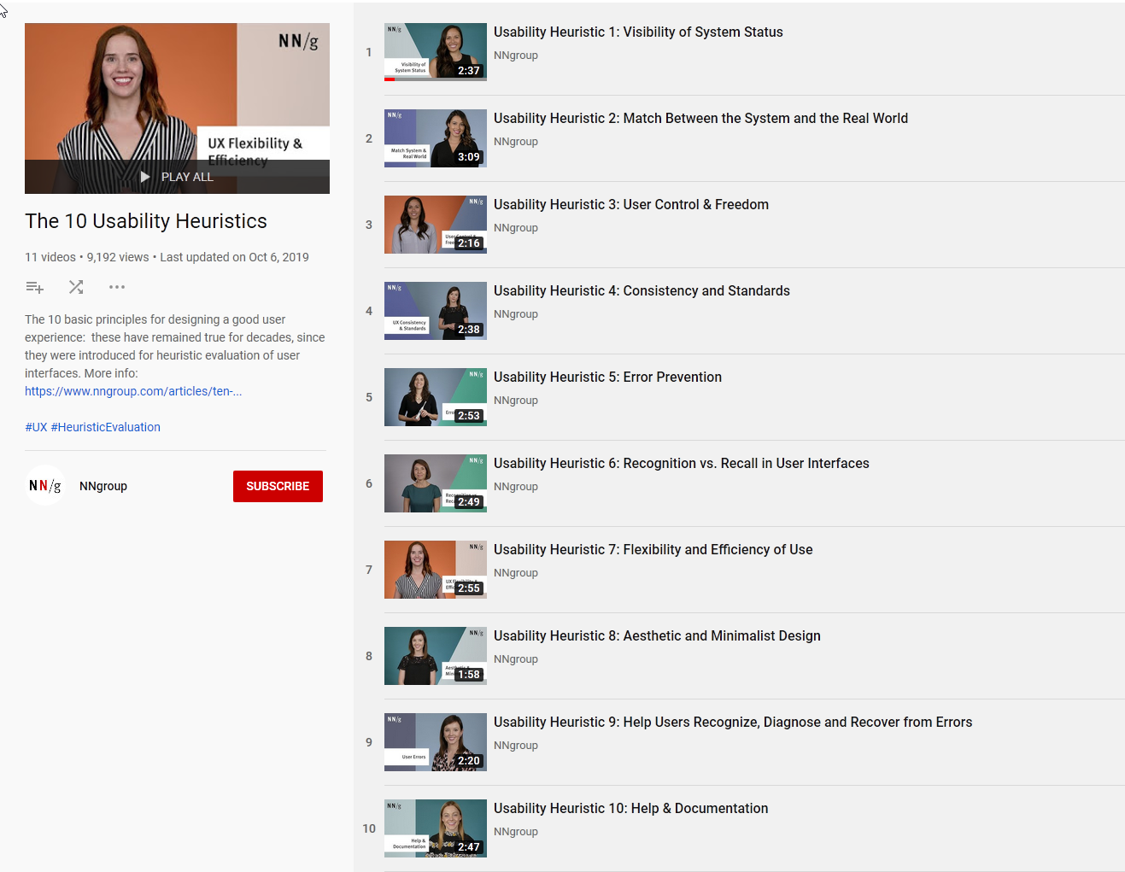
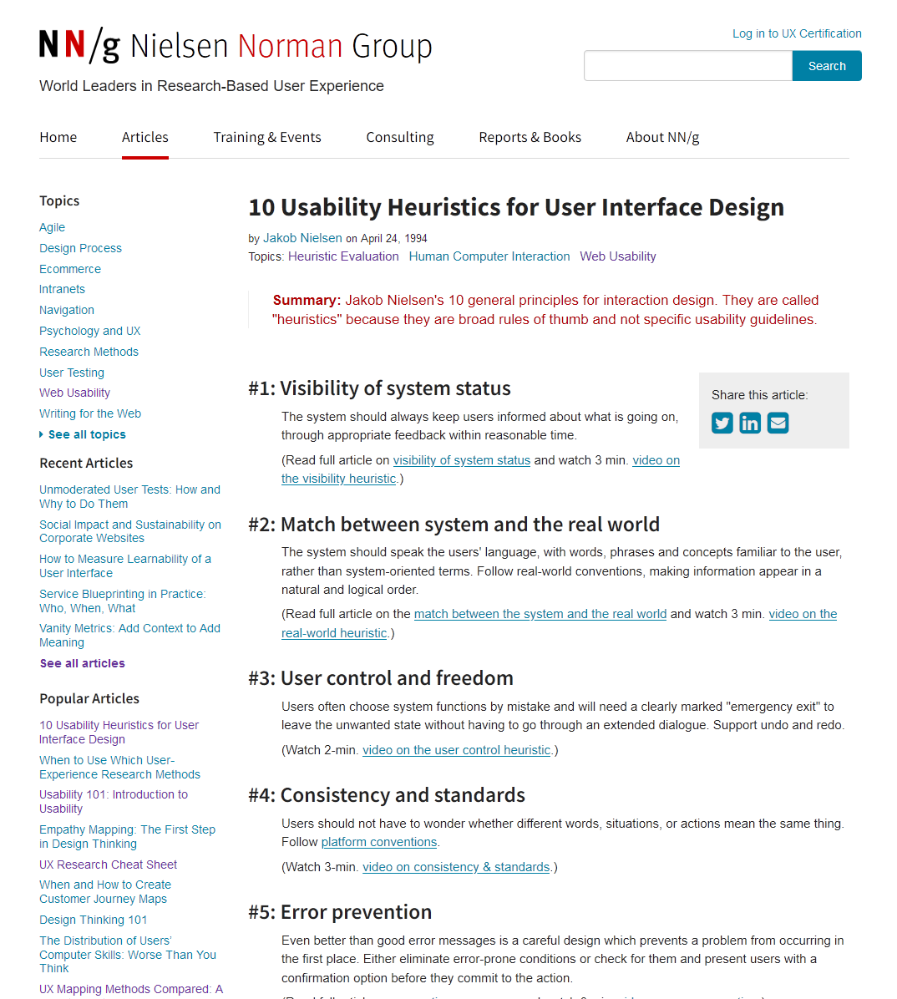
10 Nielsen’s Usability Heuristics
https://www.youtube.com/playlist?list=PLJOFJ3Ok_idtb2YeifXlG1-TYoMBLoG6I
https://www.nngroup.com/articles/ten-usability-heuristics/

Slide 35
10 Nielsen’s Usability Heuristics
https://www.nngroup.com/articles/ten-usability-heuristics/
#1: Visibility of system status
#2: Match between system and the real world
#3: User control and freedom
#4: Consistency and standards
#5: Error prevention
#6: Recognition rather than recall
#7: Flexibility and efficiency of use
#8: Aesthetic and minimalist design
#9: Help users recognize, diagnose, and recover from errors
#10: Help and documentation

Slide 36
#1: Visibility of system status
The system should always keep users informed about what is going on, through appropriate feedback within reasonable time.
https://www.nngroup.com/articles/visibility-system-status/
Notes:
If I’m filling out a form, or a multi-step process in general…can I understand easily my current position in that process? Is there any indication about how long the form is? When I submit the form, do I receive an appropriate feedback in a reasonable amount of time?

Slide 37

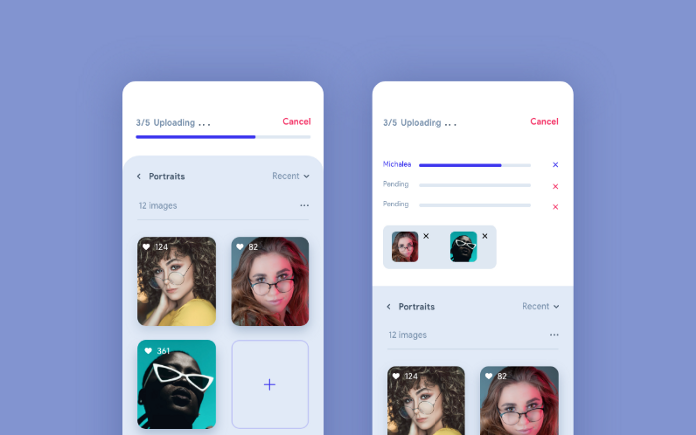

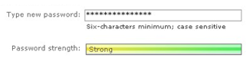
#1: Visibility of system status
Some examples from: http://designingwebinterfaces.com/6-tips-for-a-great-flex-ux-part-5
Notes:
the progress bar on top is indicating that 3 out of 5 images are uploaded. Here the user is well aware of the progress and can wait without any hesitation until the process has completed. Also, the user can tap on the progress bar and see the detailed upload status view.
Skeleton Loader is an animated placeholder for the information that is still loading. It mimic the structure and look of the entire view. It progressively loads the content as you can see in the image. It’s now very popular and used by many companies like Medium, LinkedIn & Facebook.

Slide 38
Which Feedback?
Time
Execution time for tasks
Space
E.g., occupation of cloud storage
Change
Ensure that the user is aware of changes that he requested (e.g., save, delete, send, …)
Action
What is happening (running, stopped, …), in a redundant way
Next steps
What will happen because of your action, and your possible next actions at this point
Completion
Clarify when a task has been finalized

Slide 39
Rule of Thumb (Time)
If the execution time is…
…Less than 1 second ⇨ just show the outcome of the action
…Around 1-2 seconds ⇨ show feedback that the action is underway
…More 2-3 seconds ⇨ show progress (percentage, estimated time, …)

Slide 40
#2: Match between system and the real world
The system should speak the users' language, with words, phrases and concepts familiar to the user, rather than system-oriented terms. Follow real-world conventions, making information appear in a natural and logical order.
Use familiar metaphors and language
https://www.nngroup.com/articles/match-system-real-world/

Slide 41
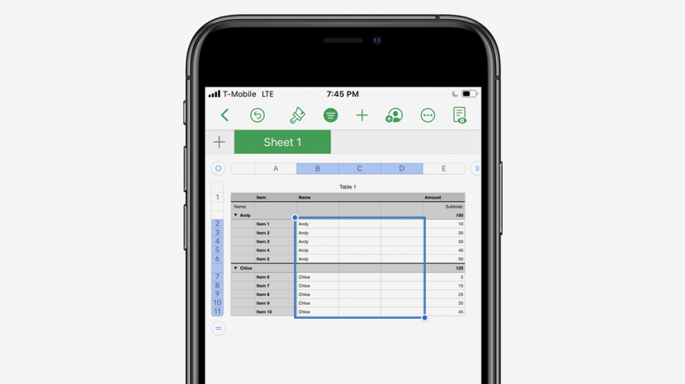

#2: Match between system and the real world
Notes:
If I click on the paintbrush, what should happen next? What is in your opinion its purpose?
While the un-labelled paintbrush icon in the Apple Numbers and Pages apps looks like a paintbrush, it does not, in fact, function as one, and is instead used to indicate a formatting menu, which can be a source of confusion for new users who might be expecting a paintbrush to allow them to paint, as it would in real life.

Slide 42
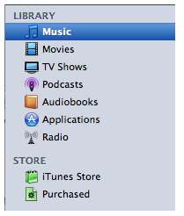
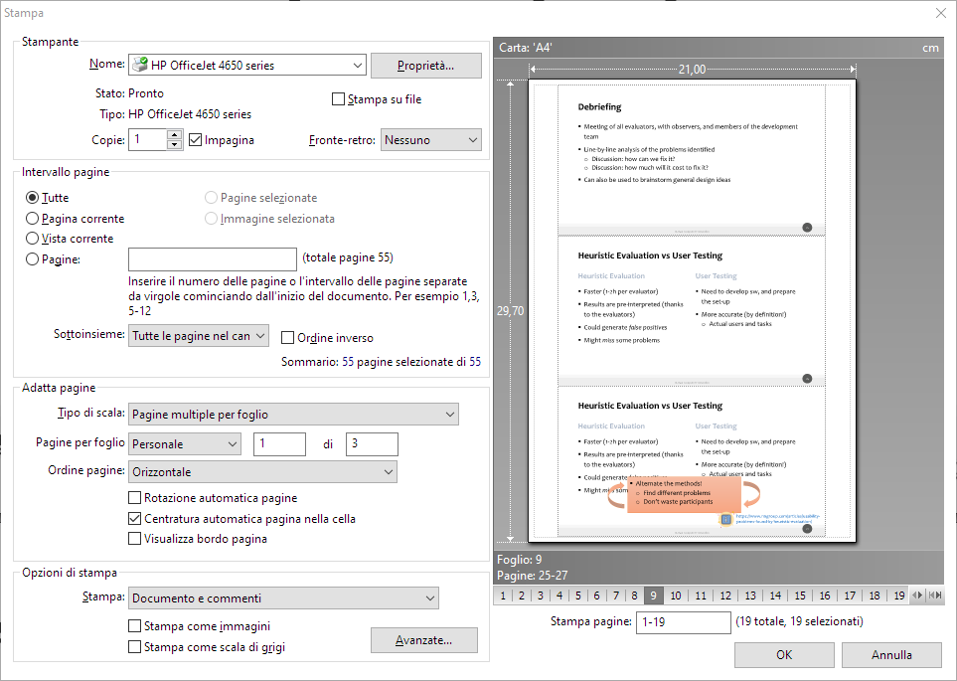
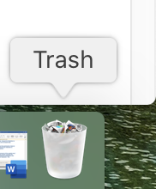
#2: Match between system and the real world
Notes:
THE ICON ARE TAKEN FROM THE REAL WORLD (ALSO ”LIBRARIES”). The icon for the MacBook trash bin closely resembles a real-life trash bin and users can drop items in it, just as they would with a physical trash bin. This helps users recognize and understand what the purpose of the trash feature is and how it functions.
The methaphonre here is showing what we will obtain on a sheet of paper, the preview…and we are familiar with sheets of paper, in our real world. So here we are matching exactly the system and the real world, as in the title of heuristic #2

Slide 43
Exploit Familiarity
Familiar Metaphors
Files, paper, folders, highlighters, …
Familiar Language
Avoid jargon, acronyms, etc. that could be unknown to your users
Familiar Categories
Familiar Choices
E.g., explain the meaning of the error message (what happened, what are the consequences, what are the available options) in a simple way
Notes:
Familiarity also depends on the target population.

Slide 44
#3: User control and freedom
Users often choose system functions by mistake and will need a clearly marked "emergency exit" to leave the unwanted state without having to go through an extended dialogue. Support undo and redo.
Notes:
Redo a form everytime

Slide 45
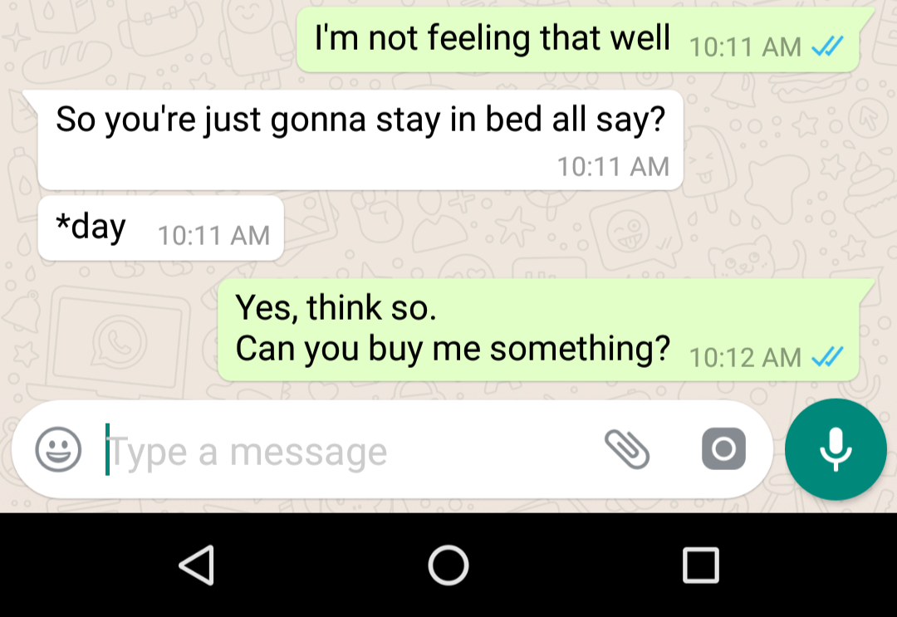
#3: User control and freedom

Slide 46
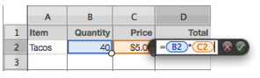
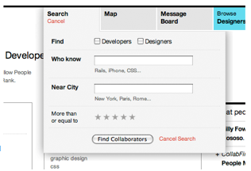
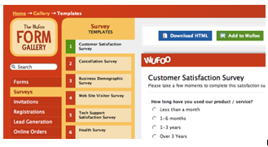
#3: User control and freedom

Slide 47
Suggestions
Always provide a “back” (or equivalent) button
Allow users to “explore” different alternative paths
Except for one-shot wizard-like paths, aimed at novices or first-time users

Slide 48
#4: Consistency and standards
Users should not have to wonder whether different words, situations, or actions mean the same thing. Follow platform conventions.
Notes:
Search in one page and find in another page…do they mean the same thing?
Follow the conventions that already exist on the specific platform. On Iphones, for instance, you have a differen way to go back with respect to android devices.

Slide 49
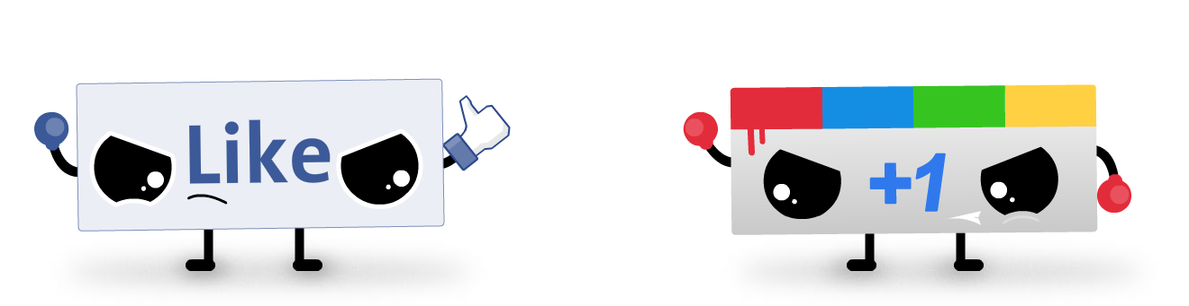
#4: Consistency and standards
BrandFlakesforBreakfast’s Illustration
Notes:
Google Plus ambitiously launched “+1” to counter Facebook’s “Like” without much success. Facebook’s “Like” already became a standard and sites like LinkedIn adopted it without contesting, so this operation by Google was unsuccessful

Slide 50
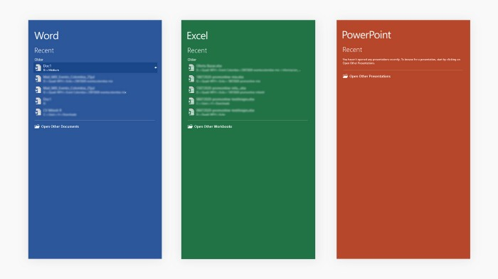
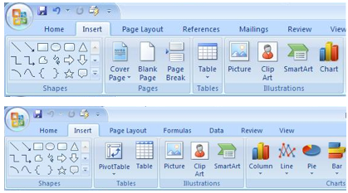
#4: Consistency and standards
Notes:
Two different apps (probalby word and power point), but there is consistency. If you learn how to use word and insert a shape, you are probably able to insert a shape in powerpoint. Consistency acorss a familiy of software.

Slide 51
Suggestions
Consistent layout for dialogs and forms
E.g., position of the navigation elements
E.g., position of the confirmation buttons
Consistent meaning for Ok/Cancel, Yes/No choices
E.g., avoid: “Do you want to interrupt task?”
Still better, label buttons with the actual effect “Insert”, “Interrupt”, …
Categories, lists of names, geographical regions, etc, should be taken from “standard” vocabularies
Notes:
For the position. Ok on the left, cancel on the right
Consistent meaning for the adopted dialogues. So let’s suppose to have this question inside a dialogue
“do you want to interrupt the task” –> and then the options are ok/cancel…. what should I click???

Slide 52
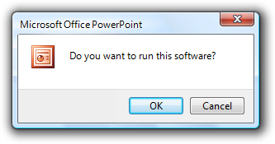


Examples
Bad
Acceptable
Better
source: https://docs.microsoft.com/en-us/windows/win32/uxguide/win-dialog-box
Notes:
You don’t naturally answer cancel to that question.
Better -> make it explicit! Maybe the user did not read the question properly and so there is the risk that he will miss the answer

Slide 53
#5: Error prevention
Even better than good error messages is a careful design which prevents a problem from occurring in the first place. Either eliminate error-prone conditions or check for them and present users with a confirmation option before they commit to the action.
https://www.nngroup.com/articles/slips/

Slide 54
Suggestions
Preventing data loss
Prevent clutter
Prevent confusing flow
Prevent bad input
Prevent unnecessary constraints (e.g., provide defaults for missing data)
Notes:
Inside a form, if you know that it’s a mandatory field and you have a default option, just include it in the field

Slide 55
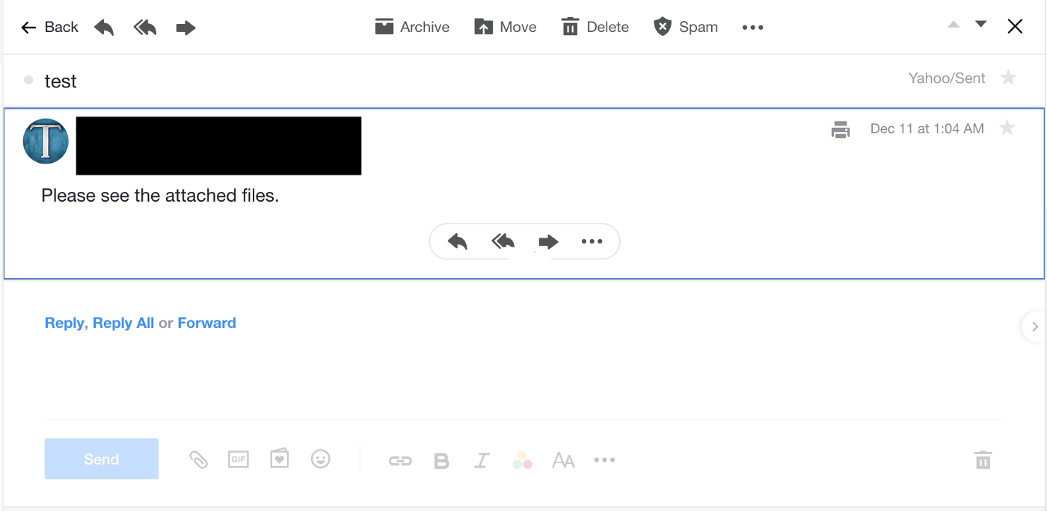
#5: Error prevention
Notes:
Yahoo Mail does not prompt users when they forget to insert an attachment, therefore users can send an email without attaching the file that they intended to attach.

Slide 56
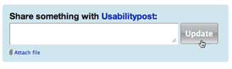
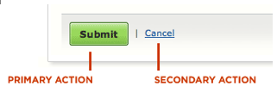
#5: Error prevention
Notes:
Here the update button is disabled until I attach I file.
Visually, we know that the primary action is different from the secondary button

Slide 57
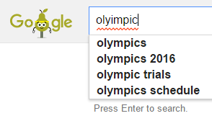
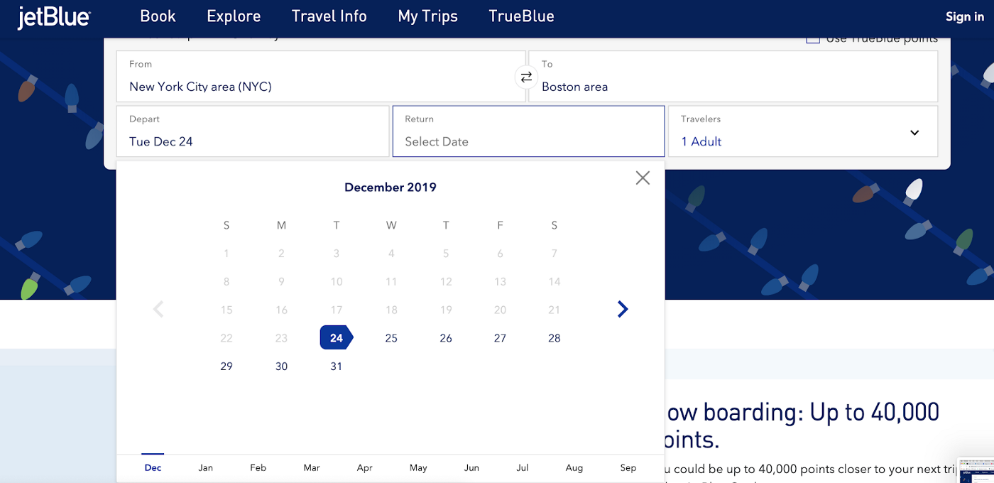
#5: Error prevention
Notes:
an example of Google Search trying to correct my spelling
When booking a plane ticket on their website, JetBlue does not allow users to pick a return date that is before their departure date in order to prevent users from accidentally choosing a date that is too early.

Slide 58
#6: Recognition rather than recall
Minimize the user's memory load by making objects, actions, and options visible. The user should not have to remember information from one part of the interface to another. Instructions for use of the system should be visible or easily retrievable whenever appropriate.
https://www.nngroup.com/articles/recognition-and-recall/

Slide 59
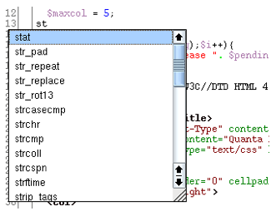
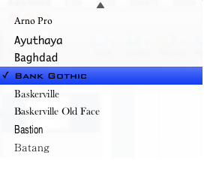
#6: Recognition rather than recall
Notes:
Autocomplete in coding -> you don’t need to remember exactly the name of a specific function, you can recognize it from a list of similar functions.

Slide 60
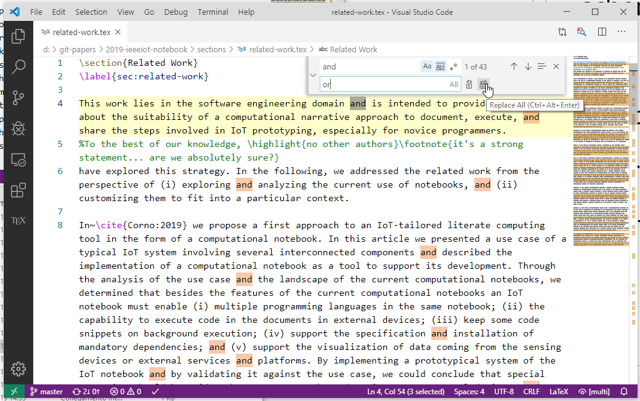
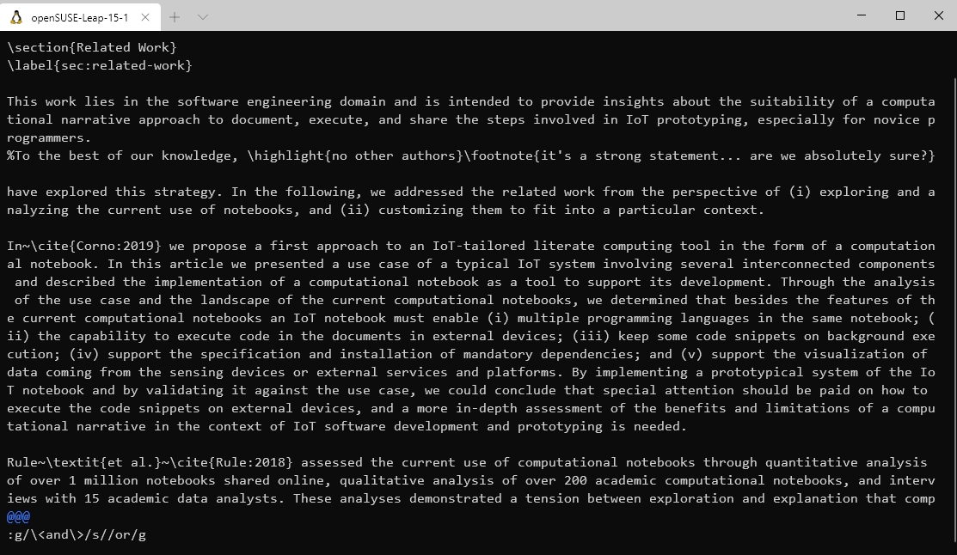
Example
Notes:
On VI -> there is no recognition at all. You have to remember the exact syntax (or probably use StackOverflow)
In VS -> there is the replace all button → it’s the same level of power, you perform the same operation, you simply have to recognize the button, without recalling anything

Slide 61
Suggestions
Avoid codes (use explicit names)
e.g., L, VL, EL, EA, …???
Avoid extra hurdles
e.g., asking for unnecessary (or premature) information
Provide previews
Code completion
Page preview
Order summary
Itinerary
…

Slide 62
#7: Flexibility and efficiency of use
Accelerators — unseen by the novice user — may often speed up the interaction for the expert user such that the system can cater to both inexperienced and experienced users. Allow users to tailor frequent actions.
Notes:
Can you provide an example of an accelerator in our context? shortcuts

Slide 63
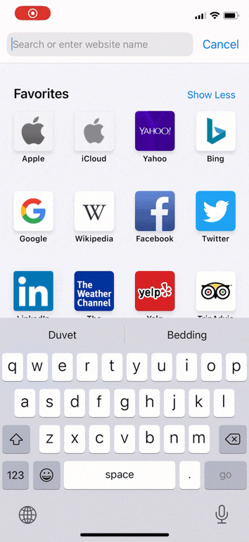
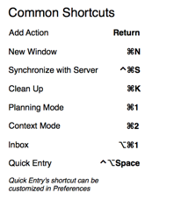
#7: Flexibility and efficiency of use
Notes:
The iOS keyboard allows swiping through the letters of a word instead of tapping them individually. This gesture is an accelerator: it helps experienced users but does not make typing harder to learn for novices.

Slide 64
Suggestions
Flexibility = Default + Options
E.g., present some popular choices, but let the user enter a custom one (train ticket machines)
Exploit background information for providing more information
E.g., weather forecasts in a calendar interface
Novice and Expert Users Have Different Needs
Support proactivity, personalization, and different interaction techniques!
Recommendations
Provide relevant information, only
Notes:
You should provide users with some default, e.g., in case of novice users, but you should also provide them with the possibility of exploring other options.

Slide 65
#8: Aesthetic and minimalist design
Interfaces should not contain information which is irrelevant or rarely needed. Every extra unit of information in an interface competes with the relevant units of information and diminishes their relative visibility.

Slide 66
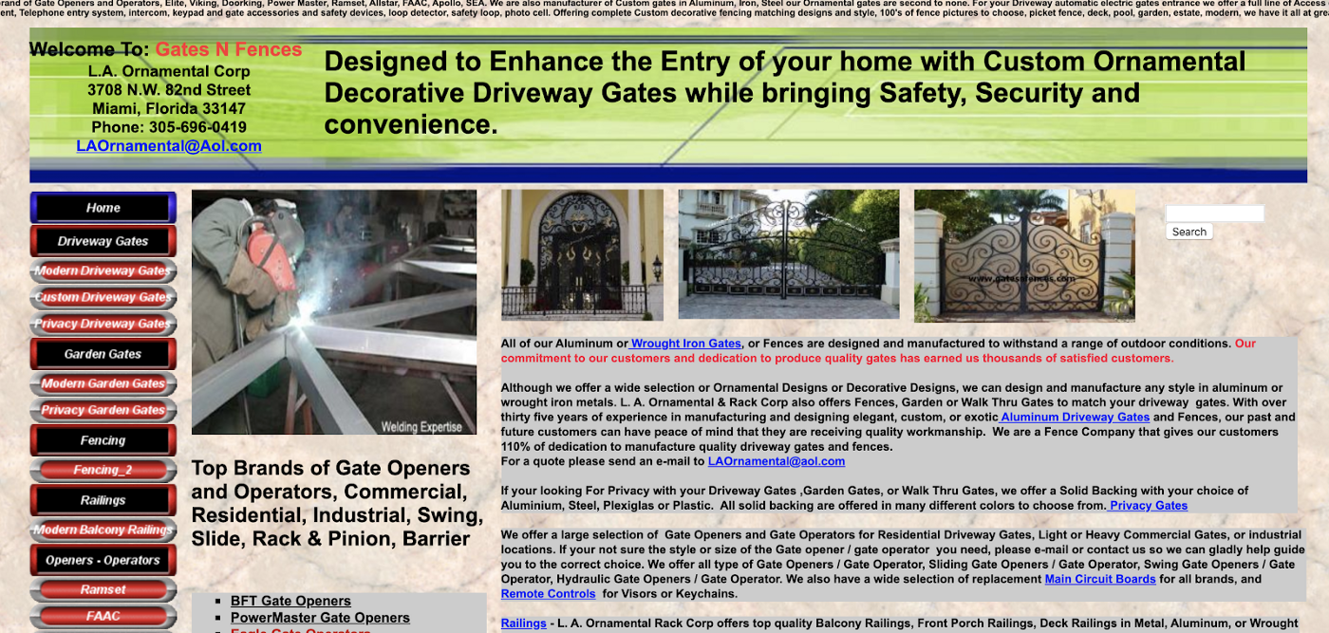
#8: Aesthetic and minimalist design

Slide 67
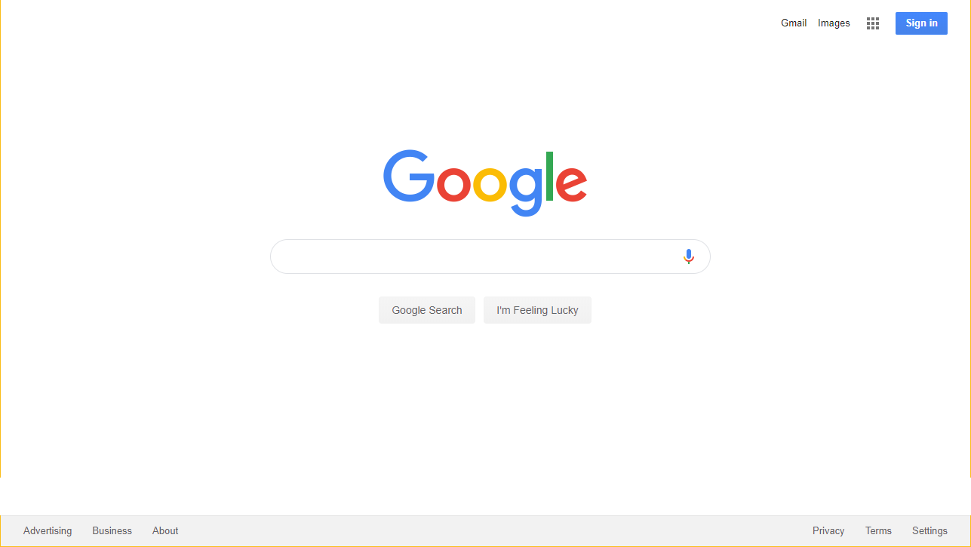
#8: Aesthetic and minimalist design
Notes:
Google search’s interface is clean, uncluttered, and simple with a minimalist design that focuses on the search bar since its user’s main goal is generally to search. I instantly know what is the main task that I can perfom.
Timesheet -> simple, just one operation, description of 1 line.

Slide 68
Suggestions
Key information must be “above the fold”
Especially on low-resolution devices
Keep high signal-to-noise ratio
Colors, fonts, backgrounds, animations, …
Borders, dividers, …
Minimalistic login experience
Accept redundant ways of entering information
Prune features that are outside the “core” functionality
Notes:
Your interface should clearly display key information, without mixing them with other content
You should adopt colors, fonts, bacground in an approriate way, without producing cluttered user interfaces

Slide 69
#9: Help users recognize, diagnose, and recover from errors
Error messages should be expressed in plain language (no codes), precisely indicate the problem, and constructively suggest a solution.

Slide 70
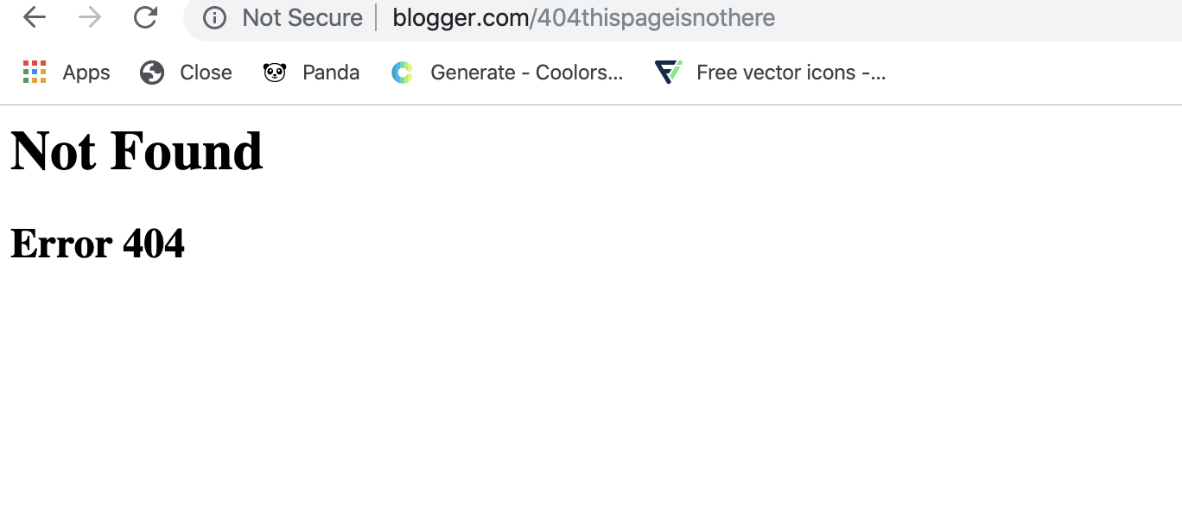
#9: Help users recognize, diagnose, and recover from errors
Notes:
The classic 404 error page…it does not tell users anything about what went wrong or how they can fix it, which can easily confuse users.

Slide 71
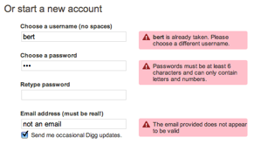
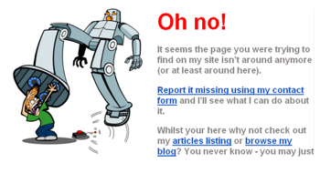
#9: Help users recognize, diagnose, and recover from errors
Notes:
PROVIDE NEGATIVE EXAMPLES! E.g., 404

Slide 72
Suggestions
Make errors easy to identify
Colors, fonts, …
Make problem clear
Problem cause
Problem location
Provide a solution
Give a suggestion
Show a path forward
Propose an alternative

Slide 73
#10: Help and documentation
Even though it is better if the system can be used without documentation, it may be necessary to provide help and documentation. Any such information should be easy to search, focused on the user's task, list concrete steps to be carried out, and not be too large.

Slide 74
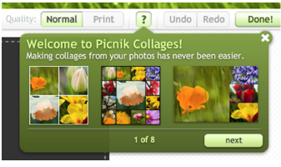
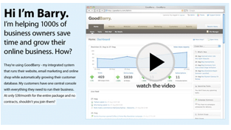
#10: Help and documentation

Slide 75
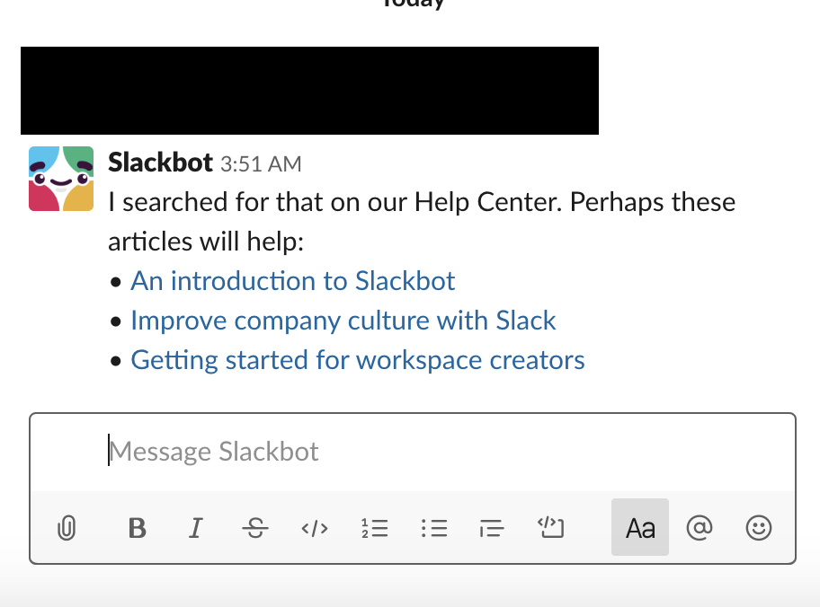
#10: Help and documentation
Notes:
Slack’s Slackbot offers users an easy and readily accessible way of getting help. All users have to do is message the bot with their question and it will help them by either answering it or providing the documentation necessary to answer their query.

Slide 76
Suggestions
Provide examples
In documentation
In complex choices
Help the user understanding the error gravity
E.g., printing outside margins
Provide ‘tips’ for showing new actions or steps
Use pop-overs to point to changes in UI (or for first usage)
Avoid too-opaque “terms and conditions” (summarize, if possible)

Slide 77
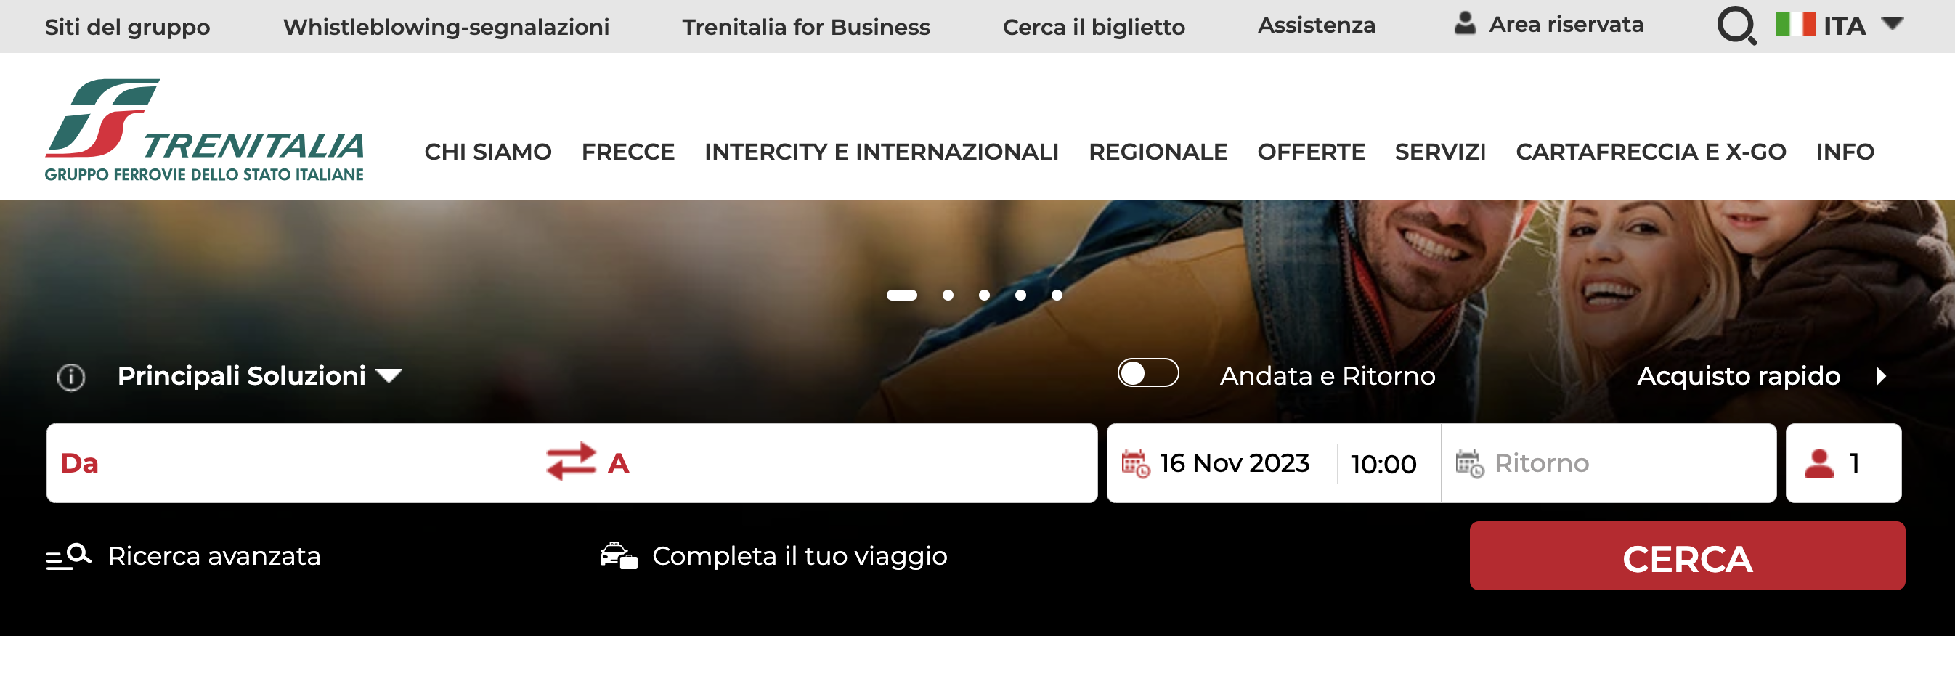
Example
Target website: https://trenitalia.com/
Trenitalia is the primary train operator in Italy
It offers national rail transport with regional trains and high-speed trains (“Frecciarossa”)
Useful tasks to spot several problems:
Explore the offers proposed by the website and buy a discounted ticket
Buy a “Frecciarossa” round trip from Turin to Rome for the winter holidays
Chat with an operator for receiveing support
In performing the tasks, you can register/login to the platform and change the language of the website, if you want

Slide 78
Example - Template
[Issue #]. [Heuristic #] [Heuristic Title]
Where: [Where the issue occurred – task, step, page]
What: [Description of the problem]
Why: [Reason why it violates the heuristic]
Severity: [0-4, according to Nielsen’s severity rating]
1. H4 Consistency and standards
Where: Specify your language.
What: The app uses “Save” for saving information, except here where it uses “Store”.
Why: It is an inconsistent terminology for the same function in the application, which can create confusion.
Severity: 3

Slide 79
Example – Violations (among many others!)
1. H1 Visibility of system status
Where: navbar logo
What: if I click on the logo in the navbar when I’m logged in, I’m redirected to another website and I’m automatically logged out from the system without any feedback
Why: the user is automatically logged out from the system without any explanation nor feedback, so she might think she is still logged in.
Severity: 3

Slide 80
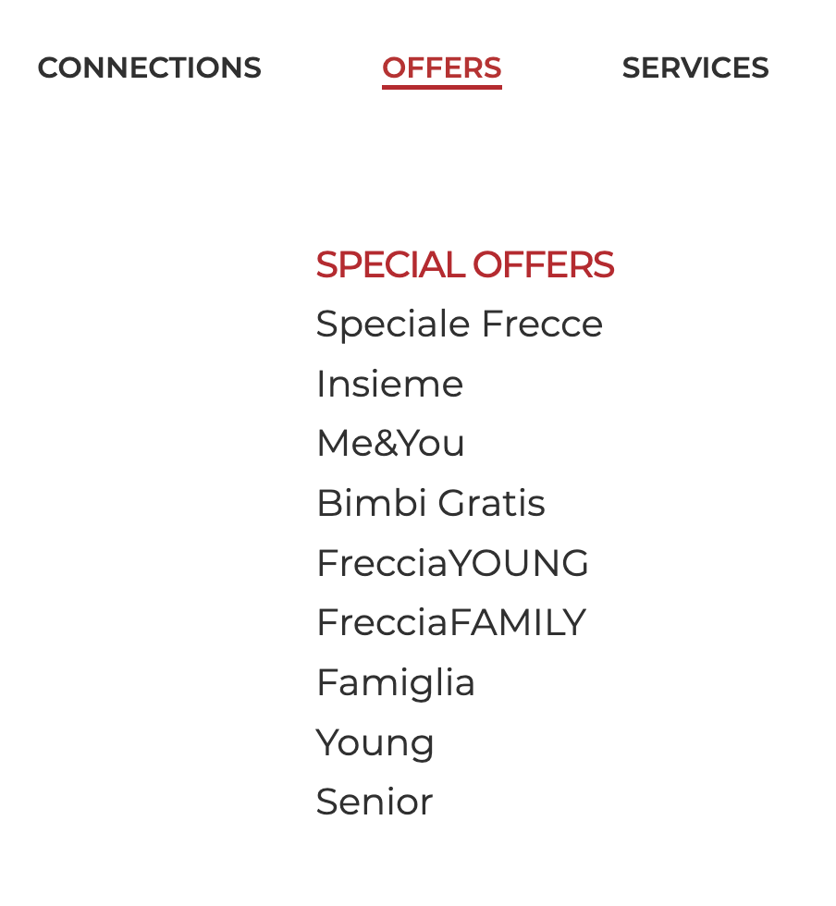
Example – Violations (among many others!)
2. H2 Match between system and the real world
Where: “offers” dropdown when the language is English
What: the menu is using Italian words even if the language is set to English
Why: the interface does not match the user’s language.
Severity: 2

Slide 81
Example – Violations (among many others!)
3. H3 User control and freedom
Where: search procedure
What: If the user selects by mistake a train, there is no easy way to modify the trip
Why: users have to restart the search procedure if they make some mistakes
Severity: 2
4. H3 User control and freedom
Where: search procedure
What: If the user starts searching as a “guest” and then wants to log-in, she is redirected to another page
Why: the user is not in control, as she would probably like to continue the search and eventually buy the tickets
Severity: 2

Slide 82

Example – Violations (among many others!)
5. H3 User control and freedom
Where: breadcrumb menus
What: the breadcrumb menus do not reflect the interaction history of the user
Why: the breadcrumb menus allow the user to navigate to pages she has never seen before (e.g., the “Offers” page), creating confusion as breadcrumb menus are typically not used in this way
Severity: 2

Slide 83
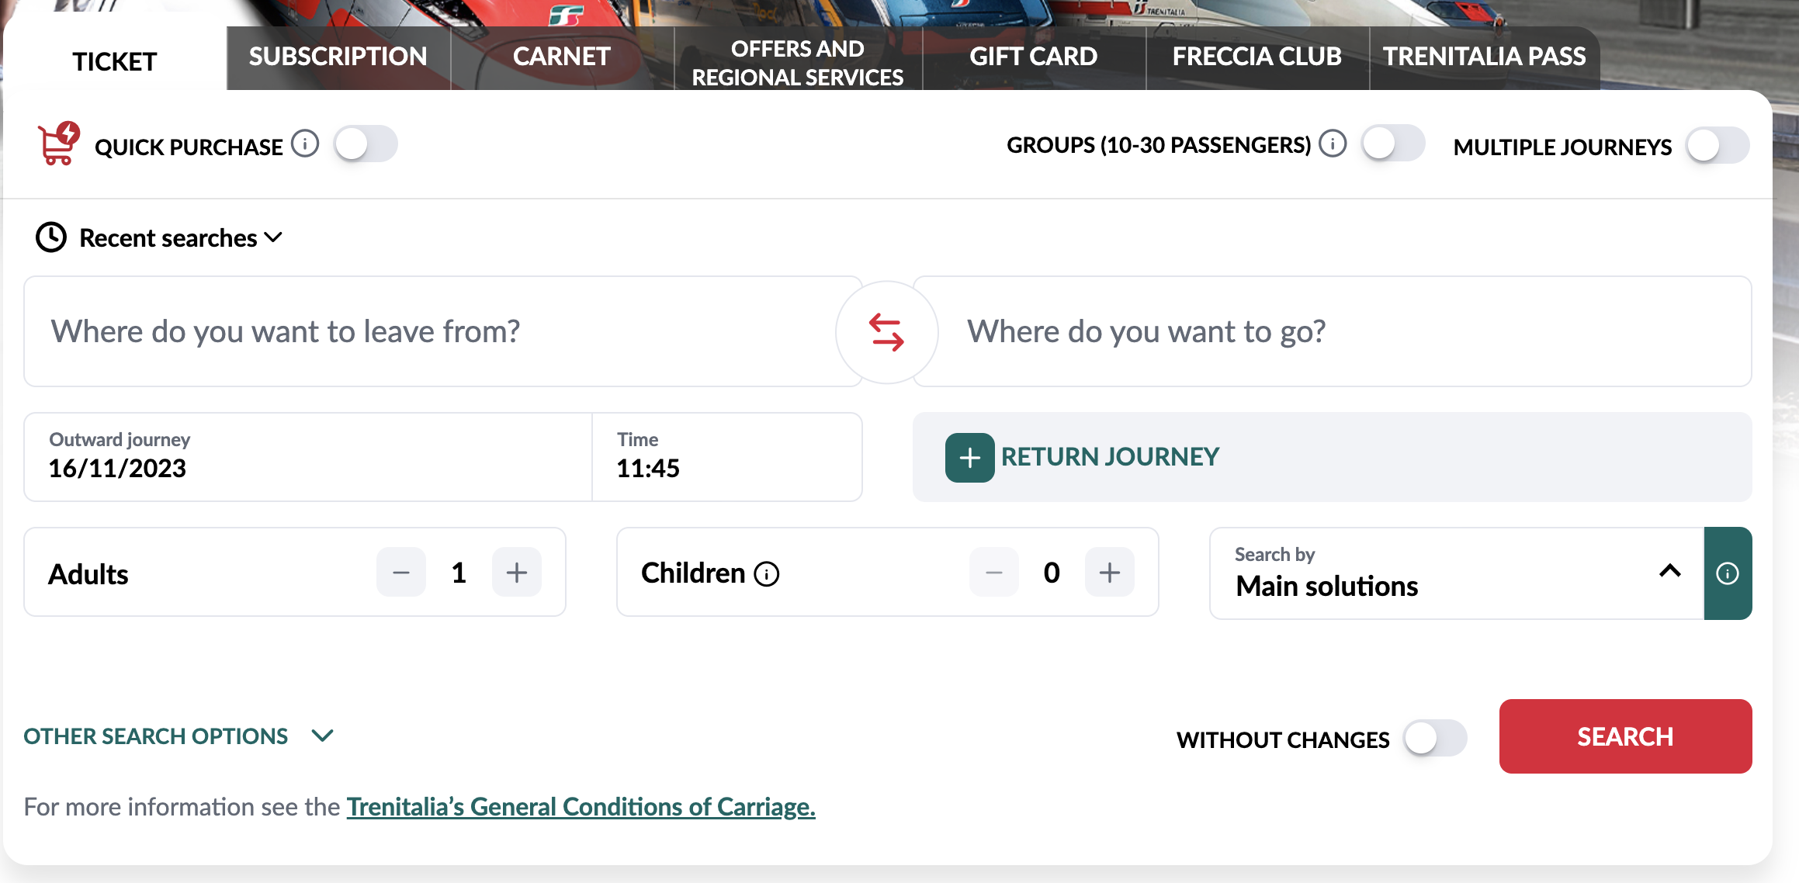
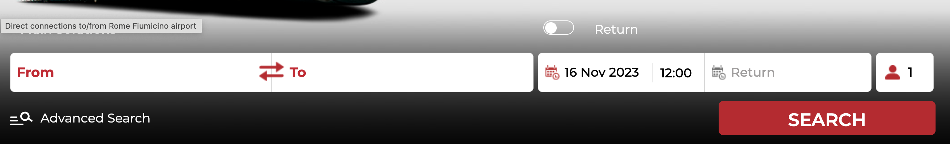
Example – Violations (among many others!)
6. H4 Consistency and standards
Where: search form
What: the website is showing two different search forms depending on whether the user is logged in into the system or not
Why: users may be confused in using two different forms for the same task
Severity: 2
7. H4 Consistency and standards
Where: Offers
What: the website is showing different offers depending on the selected language
Why: users browsing the website in English may miss some offers
Severity: 3

Slide 84
Example – Violations (among many others!)
8. H4 Consistency and standards
Where: support/help
What: the website uses “support” as a label to indicate the tools for receiving assistance, while the reserved area, when the user log in into the system, uses “help”
Why: do these links refer to the same thing?
Severity: 2

Slide 85
Example – Violations (among many others!)
9. H5 Error prevention
Where: search form
What: the user can click on search by writing whatever she wants in the “from” and “to” input fields (although there is then an error message and the form is not submitted)
Why: the button search could be disabled
Severity: 1

Slide 86
Example – Violations (among many others!)
10. H6 Recognition than recall
Where: offers (at least some of them)
What: when clicking on the button to buy a trip for a given offer, the user is redirected to the “traditional” search form
Why: the user must remember the details of the offer (e.g., the date)
Severity: 2

Slide 87
Example – Violations (among many others!)
11. H7 Flexibility and efficiency of use
Where: search form
What: there are no default/main options nor placeholders in the “form” and “to” input fields, even when the user clicks on them
Why: users may not know what to write in the fields (the name of the city? The name of the station?). Default options may speed-up the process.
Severity: 1

Slide 88
Example – Violations (among many others!)
12. H8 Aesthetic and minimalist design (same as violation #4)
Where: search procedure
What: If the user starts searching as a “guest” and then wants to log-in, she is redirected to another page
Why: the website is not offering a minimalistic login experience
Severity: 2

Slide 89

Example – Violations (among many others!)
13. H9 Help user recognize, diagnose, and recover from errors
Where: search procedure
What: the error message that appears when the user clicks on “Search” with some wrong inputs is not linked to the input fields it is referring to.
Why: users may not know/easily understand what are the input fields that are problematic
Severity: 1

Slide 90
Example – Violations (among many others!)
14. H10 Help and documentation
Where: chat support
What: the user has to insert all her personal information (email, name, Trenitalia code, …) to chat with an operator even if she is already authenticated
Why: chatting with an operator to receive support is not straightforward
Severity: 2

Slide 91
References and Acknowledgment
Alan Dix, Janet Finlay, Gregory Abowd, Russell Beale: Human Computer Interaction, 3rd Edition
Chapter 9: Evaluation Techniques
Ben Shneiderman, Catherine Plaisant, Maxine S. Cohen, Steven M. Jacobs, and Niklas Elmqvist, Designing the User Interface: Strategies for Effective Human-Computer Interaction
Chapter 5: Evaluation and the User Experience
COGS120/CSE170: Human-Computer Interaction Design, videos by Scott Klemmer, https://www.youtube.com/playlist?list=PLLssT5z_DsK_nusHL_Mjt87THSTlgrsyJ
Thanks to Fulvio Corno, past teacher of the course, for his work on some of these slides

Slide 92





License
These slides are distributed under a Creative Commons license “Attribution-NonCommercial-ShareAlike 4.0 International (CC BY-NC-SA 4.0)”
You are free to:
Share — copy and redistribute the material in any medium or format
Adapt — remix, transform, and build upon the material
The licensor cannot revoke these freedoms as long as you follow the license terms.
Under the following terms:
Attribution — You must give appropriate credit, provide a link to the license, and indicate if changes were made. You may do so in any reasonable manner, but not in any way that suggests the licensor endorses you or your use.
NonCommercial — You may not use the material for commercial purposes.
ShareAlike — If you remix, transform, or build upon the material, you must distribute your contributions under the same license as the original.
No additional restrictions — You may not apply legal terms or technological measures that legally restrict others from doing anything the license permits.
https://creativecommons.org/licenses/by-nc-sa/4.0/

